Slide 1

SPECTRAL DILATION
John Ehlers
StockSpotter.com
ehlers@stockspotter.com
Codifying the Fractal Nature
of Market Data
Impact on Technical Indicators

Slide 2
OUTLINE
John Ehlers
StockSpotter.com
ehlers@stockspotter.com
Theoretical Basis of Market Data Structure
Measured Market Data Structure
Measuring Market Data Spectrums
The Need to Think in Terms of Frequency
Frequency is the Dual of Conventional Time Waveforms
Filter Basics
Indicator Dynamics
The Impact of Spectral Dilation and What to Do About it
An Introduction to www.StockSpotter.com

Slide 3
Drunkards Walk
John Ehlers
StockSpotter.com
ehlers@stockspotter.com
Described in “MESA and Trading Market Cycles”
Drunk steps right or left with each step forward
Random Variable is position
Results in the famous Diffusion Equation
Describes the shape of a plume of smoke (or a trend)
Drunk steps in the same or opposite direction as the last step with each step forward
Random Variable is momentum
Results in the famous Wave Equation
Describes a meandering river (or a cycle)
The 2nd Order Partial Differential Equations are nearly identical
Results are that cycles and trends can coexist in a complex mixture

Slide 4
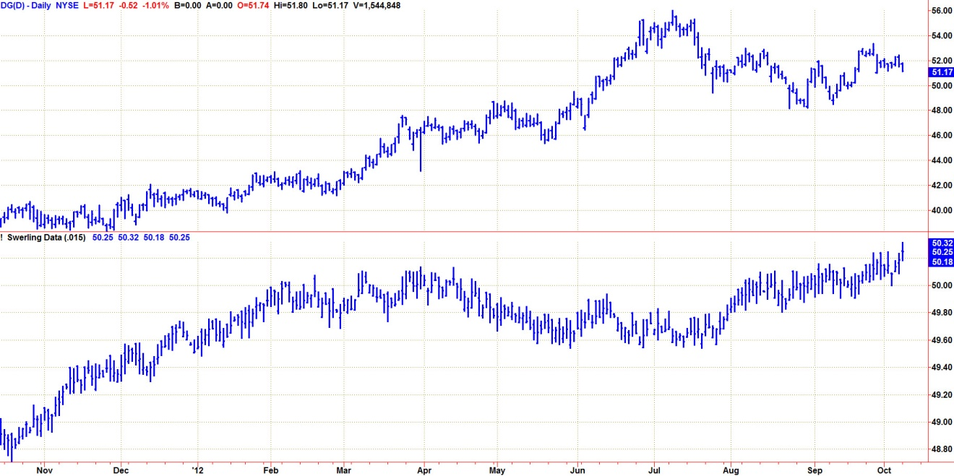
Swerling Model
John Ehlers
StockSpotter.com
ehlers@stockspotter.com
Peter Swerling statistically described radar echoes
Pulses were noisy over time – due to complex airplane shapes and changes in aspect from the fixed radar site.
Model described as pure noise with memory
I have synthesized market data as noise with an EMA
Not bad for a simple model

Slide 5
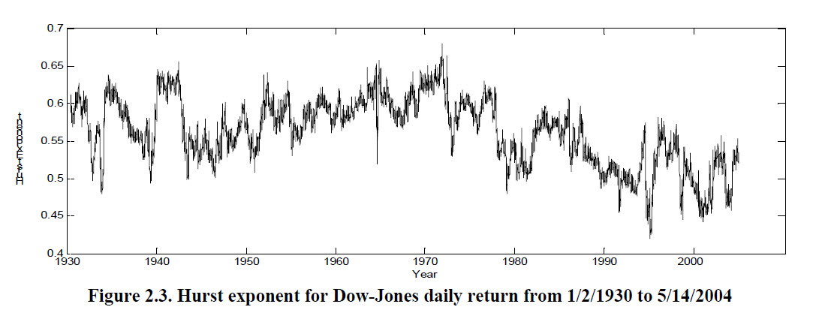
Hurst Exponent
John Ehlers
StockSpotter.com
ehlers@stockspotter.com
The Hurst Exponent describes the randomness of a data series
“Hurst Exponent and Financial Market Predictability”
By Bo Qian and Khaled Rasheed
University of Georgia

Slide 6
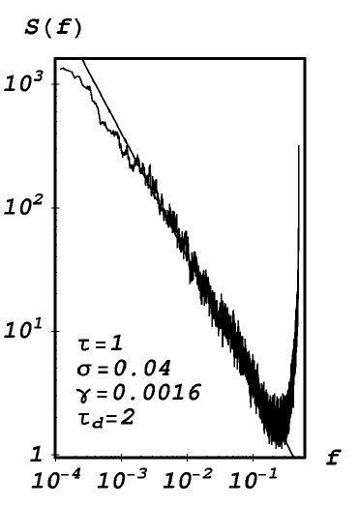
Measured & Modeled Market Spectrum
John Ehlers
StockSpotter.com
ehlers@stockspotter.com
Market spectrum amplitude models as 1/F^{α}
2*(1 – Hurst Exponent)= α
Spectral Dilation increases approximately 6 dB/Octave
1/F Noise is apparently universal
Model shows two mandates for Technical Analysis
We must stay several octaves away from the Nyquist Frequency due to Quantization Noise
Indicators must compensate for spectral dilation to get an accurate frequency response
Quantization
Noise
Spectral
Dilation
“Modelling Share Volume Traded in Financial Markets”
By V. Gontis
Lithuanian Journal of Physics, 2001, 41, No. 4-6, 551-555

Slide 7
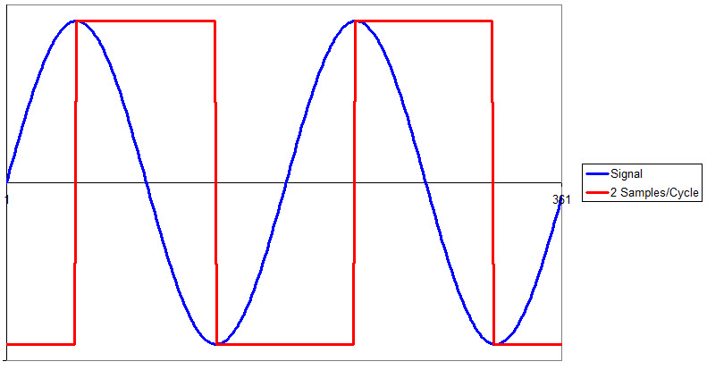
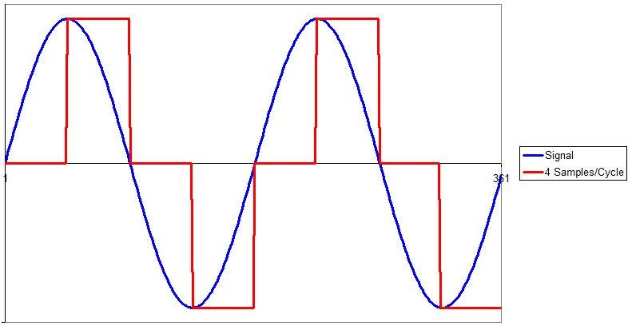
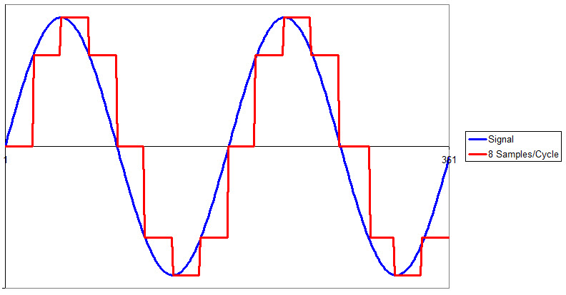
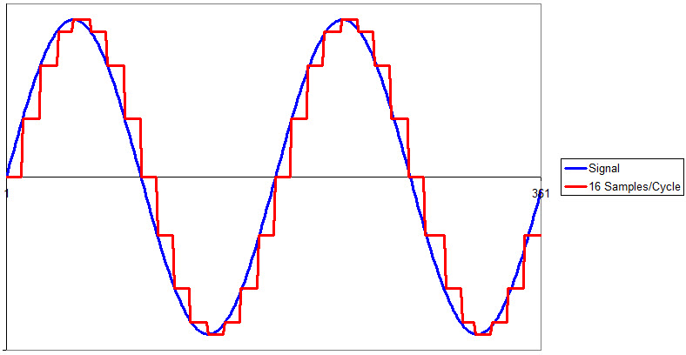
Quantization Noise
John Ehlers
StockSpotter.com
ehlers@stockspotter.com
Highest possible frequency has two samples per cycle (Nyquist Frequency)
2 day period on daily bars

Slide 8
OverSampling
John Ehlers
StockSpotter.com
ehlers@stockspotter.com
Why not reduce quantization noise by sampling more often?
For example – hourly data to trade daily bars
What is a day? 6 hours? 24 hours?
Gap openings are a data issue
Spectral dilation becomes an even larger issue because several more octaves range is included in the data

Slide 9
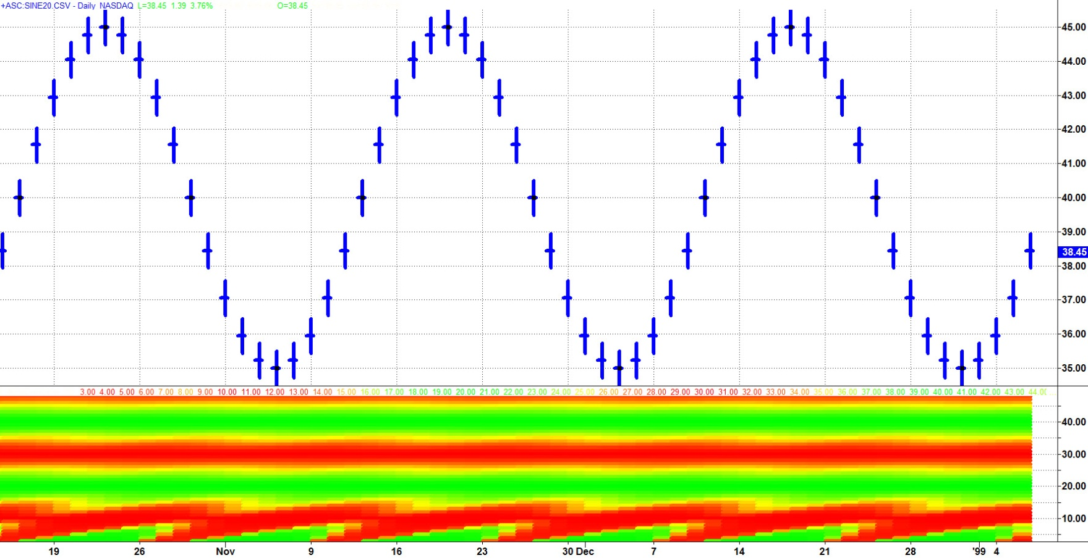
Autocorrelation
John Ehlers
StockSpotter.com
ehlers@stockspotter.com
Correlates a waveform with itself lagged in time
SwamiCharts Autocorrelation of a theoretical 20 Bar Sine Wave
Vertical Scale also shows periodicity

Slide 10
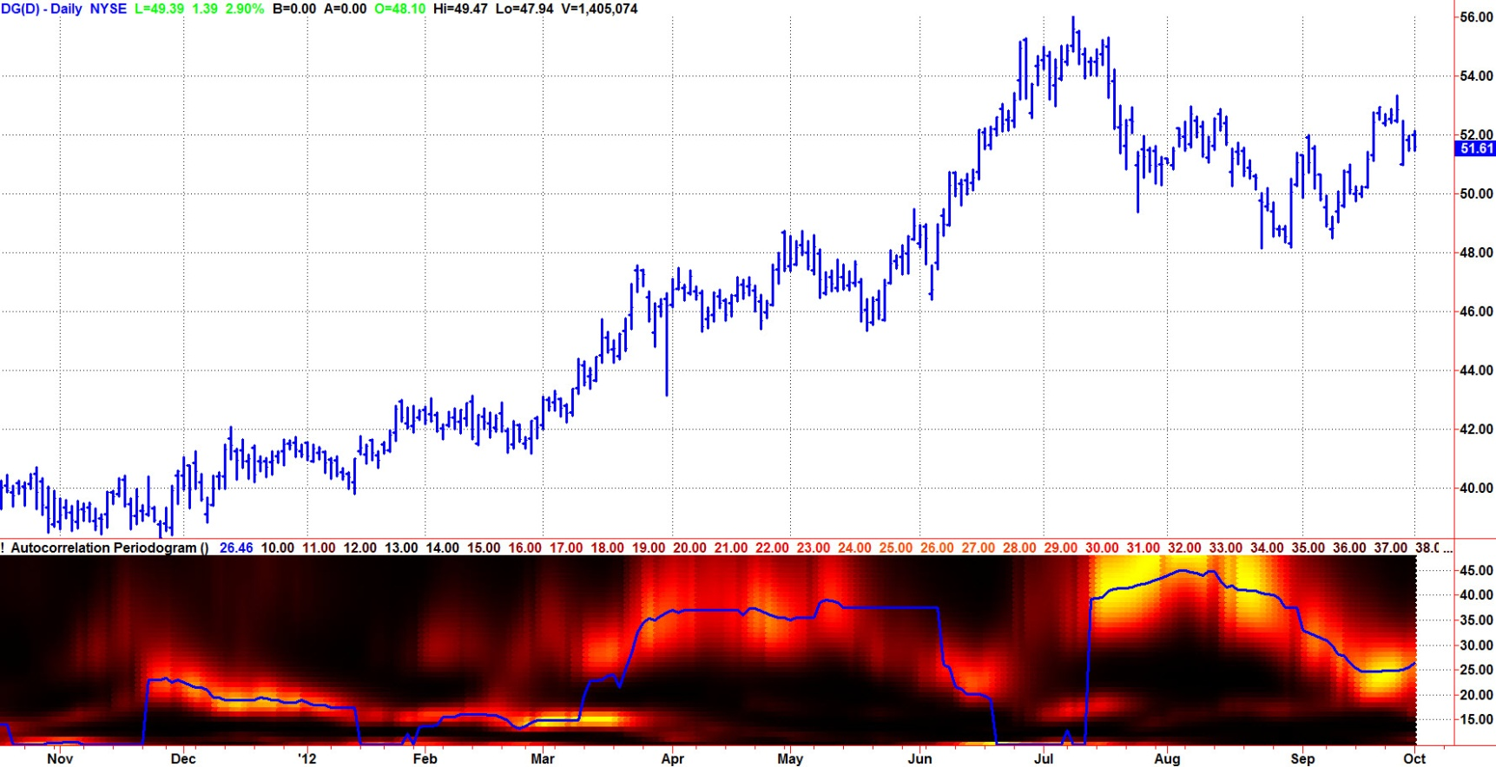
Autocorrelation Periodogram
John Ehlers
StockSpotter.com
ehlers@stockspotter.com
Autocorrelation Periodogram produces spectrum amplitudes that are range bound by the correlation coefficient
All other spectrum measurements must compensate for Spectral Dilation for a true picture of the Measured Spectrum
This is really how I “discovered” spectral dilation

Slide 11
Filter Basics
John Ehlers
StockSpotter.com
ehlers@stockspotter.com
I’m sorry! I just have to do this
Let Z⁻¹ represent one bar of delay
4 Bar Simple Moving Average: Output = (1/4 + Z⁻¹/4 + Z⁻²/4 + Z⁻³/4)*(Input Data)
Transfer Response = H(z) = Output / (Input Data)
More Generally: H(z) = b0 + b1*Z⁻¹ + b2*Z⁻² + b3*Z⁻³ + b4*Z⁻⁴ + ……….+ bN*Z^{-N}
An EMA uses a previously calculated value, so with still more generality:
Therefore, filter transfer response is just a ratio of polynomials
The polynomials can be factored into their zeros
Zeros in the denominator are called poles
The rate of filter rolloff is 6 dB / Octave per Pole
Since we must use simple filters in trading we have only a few poles
in the transfer response - BUT – the data are increasing at the rate
of 6 dB / Octave. The result is there is no real filtering.

Slide 12
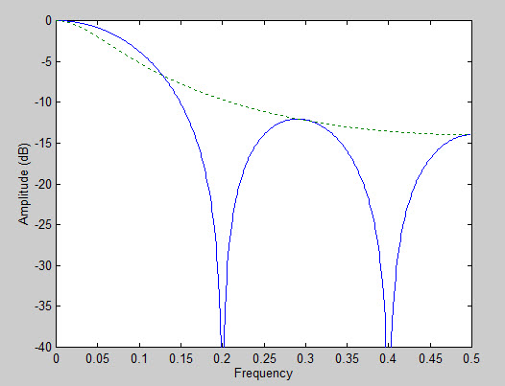
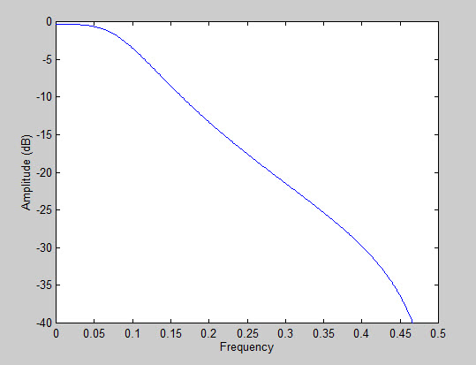
SMOOTHING FILTERS
John Ehlers
StockSpotter.com
ehlers@stockspotter.com
The real reason to use averages or smoothing filters is to remove quantization noise
Take Your Pick
10 Bar SMA and EMA
10 Bar SuperSmoother
EMA (1 pole)
SMA
2 double zeros

Slide 13
SuperSmoother Filter Code
John Ehlers
StockSpotter.com
ehlers@stockspotter.com
SuperSmoother Filter
© 2013 John F. Ehlers
a1 = expvalue(-1.414*3.14159 / 10);
b1 = 2*a1*Cosine(1.414*180 / 10);
c2 = b1;
c3 = -a1*a1;
c1 = 1 - c2 - c3;
Filt = c1*(Close + Close[1]) / 2 + c2*Filt[1] + c3*Filt[2];
Code Conversion Notes:
Filter is tuned to a 10 Bar Cycle (attenuates shorter cycle periods)
Arguments of Trig functions are in degrees
[N] means value of the variable “N” bars ago

Slide 14
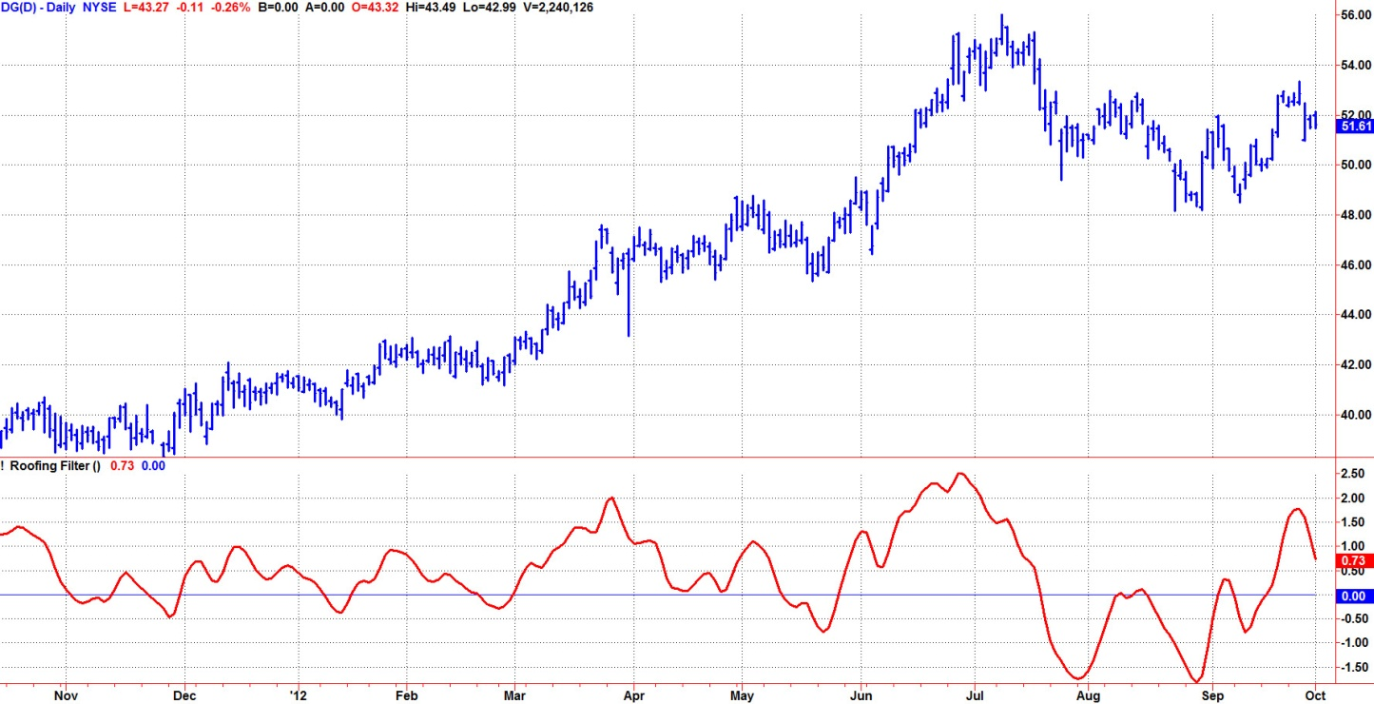
HighPass Filter
John Ehlers
StockSpotter.com
ehlers@stockspotter.com
HighPass Filters are “detrenders” because they attenuate low frequency components
One pole HighPass and SuperSmoother does not produce a zero mean
Because low frequency spectral dilation components are “leaking” through
The one pole HighPass Filter response

Slide 15
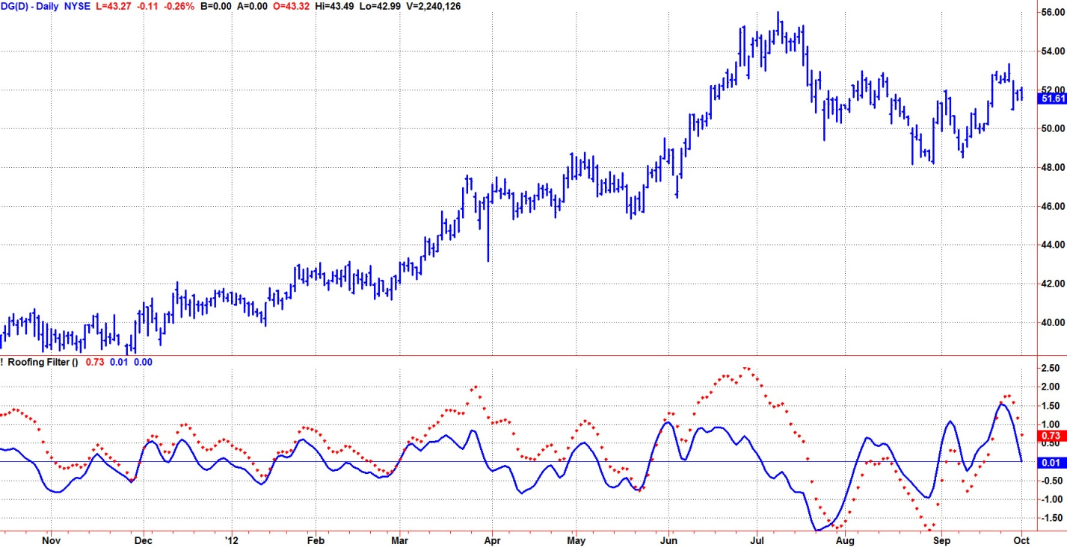
Roofing Filter
John Ehlers
StockSpotter.com
ehlers@stockspotter.com
Comprised of a two pole HighPass Filter and a SuperSmoother
The Roofing Filter guarantees only the desired frequency components will be passed for analysis

Slide 16
Roofing Filter Code
John Ehlers
StockSpotter.com
ehlers@stockspotter.com
Roofing Filter
© 2013 John F. Ehlers
//Two Pole Highpass filter passes cyclic components whose periods are shorter than 48 bars
alpha1 = (Cosine(.707*360 / HPPeriod) + Sine (.707*360 / 48) - 1) / Cosine(.707*360 / 48);
HP = (1 - alpha1 / 2)*(1 - alpha1 / 2)*(Close - 2*Close[1] + Close[2]) + 2*(1 - alpha1)*HP[1] - (1 - alpha1)*(1 - alpha1)*HP[2];
//Smooth with a Super Smoother Filter
a1 = expvalue(-1.414*3.14159 / 10);
b1 = 2*a1*Cosine(1.414*180 / 10);
c2 = b1;
c3 = -a1*a1;
c1 = 1 - c2 - c3;
Filt = c1*(HP + HP[1]) / 2 + c2*Filt[1] + c3*Filt[2];
Code Modification Notes:
HP Filter is tuned to a 48 Bar Cycle (attenuates longer cycle periods)
SuperSmoother is tuned to a 10 Bar Cycle (attenuates shorter cycle periods)
Arguments of Trig functions are in degrees
[N] means value of the variable “N” bars ago

Slide 17
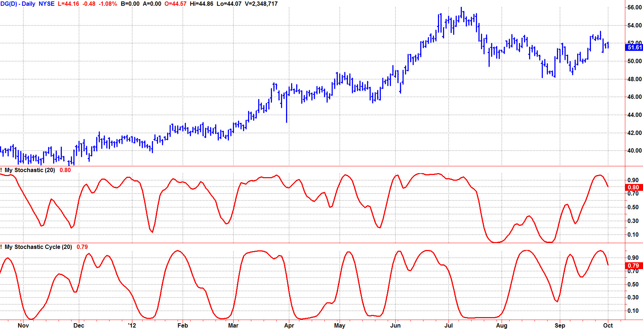
Impact of Spectral Dilation On Traditional Indicators
John Ehlers
StockSpotter.com
ehlers@stockspotter.com
Spectral Dilation has impacted (distorted?) the interpretation of virtually all indicators
Conventional Stochastic
Stochastic preceded by a Roofing Filter

Slide 18
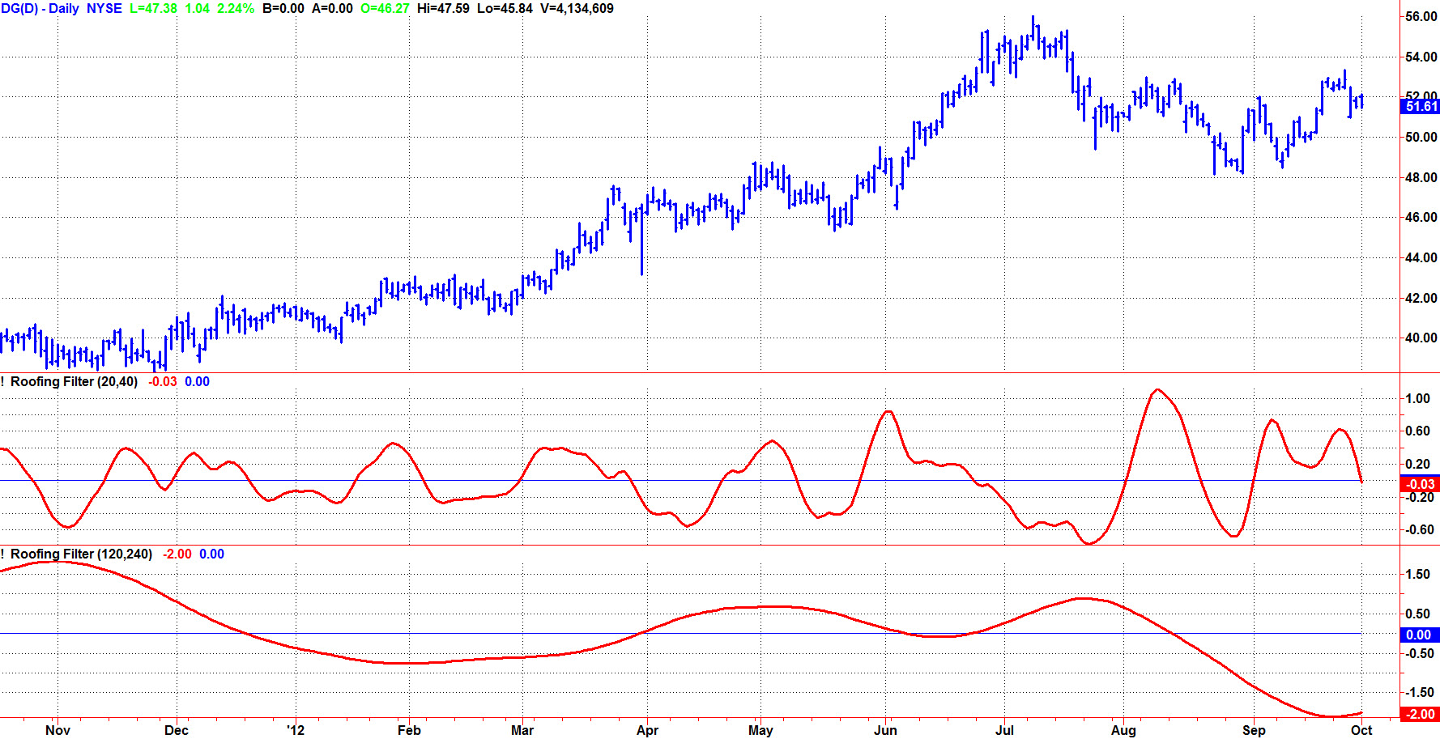
Roofing Filter Can Be An Indicator Itself
John Ehlers
StockSpotter.com
ehlers@stockspotter.com
Cycle Period is about twice the desired trade duration
2 week nominal trade duration
3 month nominal trade duration

Slide 19
John Ehlers
StockSpotter.com
ehlers@stockspotter.com
Even better DSP indicators DO exist

Slide 20

StockSpotter.com
John Ehlers
StockSpotter.com
ehlers@stockspotter.com
Analyzes over 5000 Stocks & ETFs each day
Free indicator analysis
Includes Advanced SwamiCharts
Free and Premium Screeners
Watchlists
Swing Trading signals called – IN ADVANCE
Performance is transparently tracked
Monte Carlo Analysis of Performance
Technical Presentations (this webinar is there)
This QR code will take
you to this presentation
at StockSpotter.com

